Slide 1
CLASSIFICATION TECHNIQUES
Classification is about determining the class of a given record by applying a classification model.
Classification Techniques:
  1. Decision Trees (e.g. ID3, C4.5, C5.5(j48))
  2. Rule Based Algorithms
  3. K- Nearest Neighbor Algorithm
  4. Bayesian Classifier (A Statistical Method)
  5. ANN (Artificial Neural Nets)

Slide 2
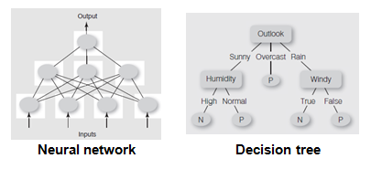
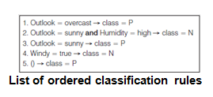
Forms of Some Classification Models

Slide 3
Classification Rules
A rule is an IF…THEN structure that states a fact about the data set.
Exp: Credit Card Application
IF (20000 < income < 40000) And (ownHouse= ‘YES’)
THEN class= “safe customer”

Slide 4
Steps of Classification
3 steps in classification
Construct model for class attribute as a function of the values of other attributes.
  Given a collection of records (training set )
  Each record contains a set of attributes, one of the attributes is the class.
Evaluate model
  A test set is used to determine the accuracy of the model. Usually, the given data set is divided into training and test sets, with training set used to build the model and test set used to validate it.
Use model
  Goal: previously unseen records should be assigned a class as accurately as possible.

Slide 5
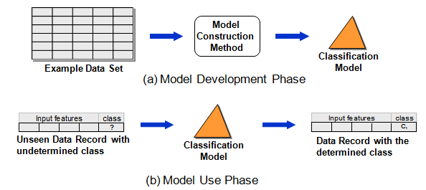
Construct a classification model to determine the class of a given record

Slide 6
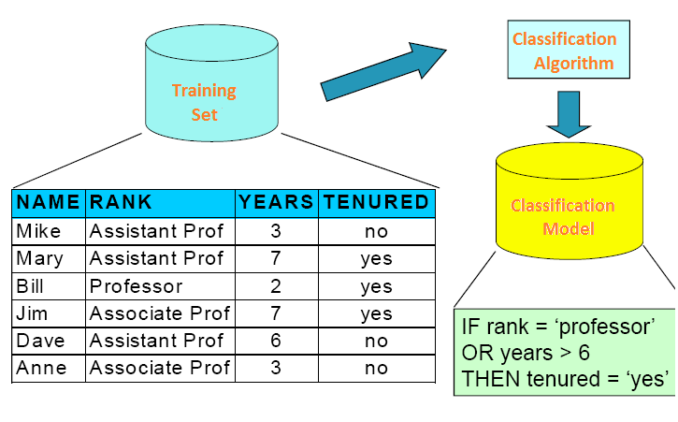
Constructing Model

Slide 7
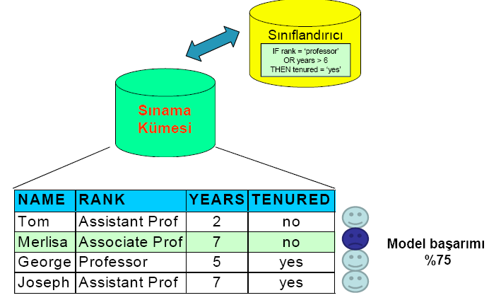
Evaluating Model
Test Set
Accuracy
75%

Slide 8
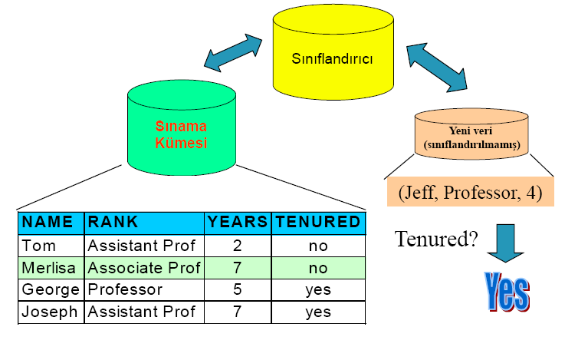

Using Model
To classify a new data according to constructed model.
Classifier
Test Set
Unseen Record

Slide 9
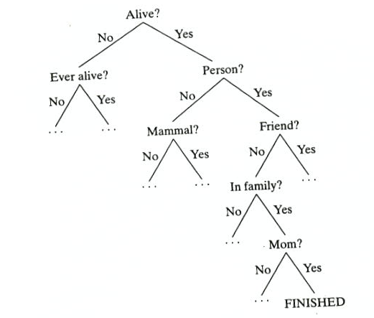
DECISION TREE
A decision tree is a tree where the root and each internal node is labeled with a question.

Slide 10
DECISION TREE
Constructing decision tree is a recursive problem
  Select an attribute to place at the root node
  Make branch for each posibble value of attribute
  Repeat recursively for each branch
  Stop when data can’t be split any further

Slide 11
Decision Tree Advantages & Disadvantages
Advantages:
Easy to use and efficient
Rules are easily generated and interpreted
Tree size is independent from data (good for large scale databases)
Easy to İntegrate with databases.
Disadvantages:
Not easy to handle continous data
Domains must be divided in to categories, not all domains appropriate for this
Handling missing data is difficult

Slide 12
Weather Data: Play or not Play?
Outlook | Temperature | Humidity | Windy | Play?
sunny | hot | high | false | No
sunny | hot | high | true | No
overcast | hot | high | false | Yes
rain | mild | high | false | Yes
rain | cool | normal | false | Yes
rain | cool | normal | true | No
overcast | cool | normal | true | Yes
sunny | mild | high | false | No
sunny | cool | normal | false | Yes
rain | mild | normal | false | Yes
sunny | mild | normal | true | Yes
overcast | mild | high | true | Yes
overcast | hot | normal | false | Yes
rain | mild | high | true | No

Slide 13
Example Tree for “Play?”
Outlook
sunny
overcast
rain
Humidity
Yes
Windy
high
normal
true
false
No
Yes
No
Yes

Slide 14
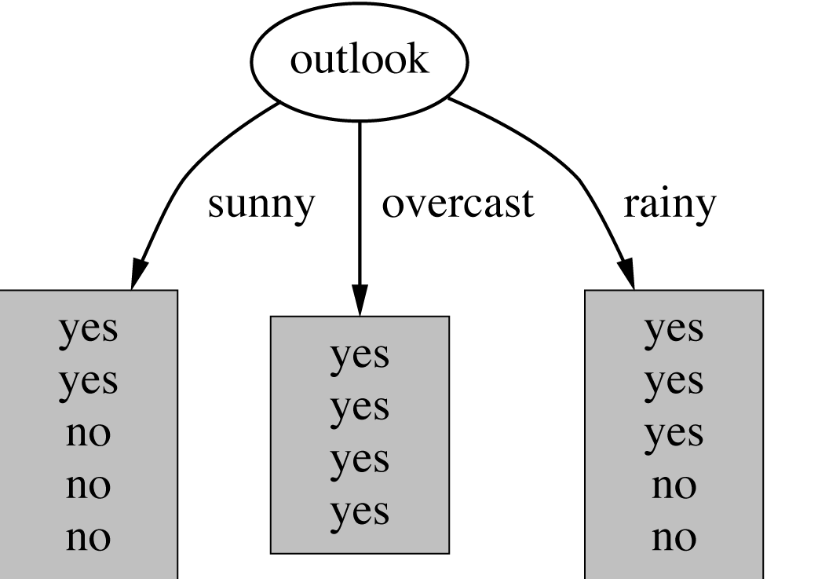
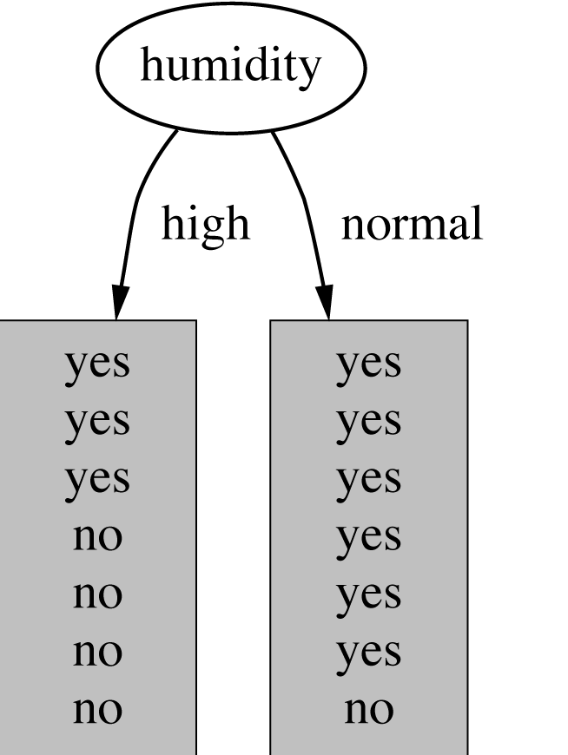
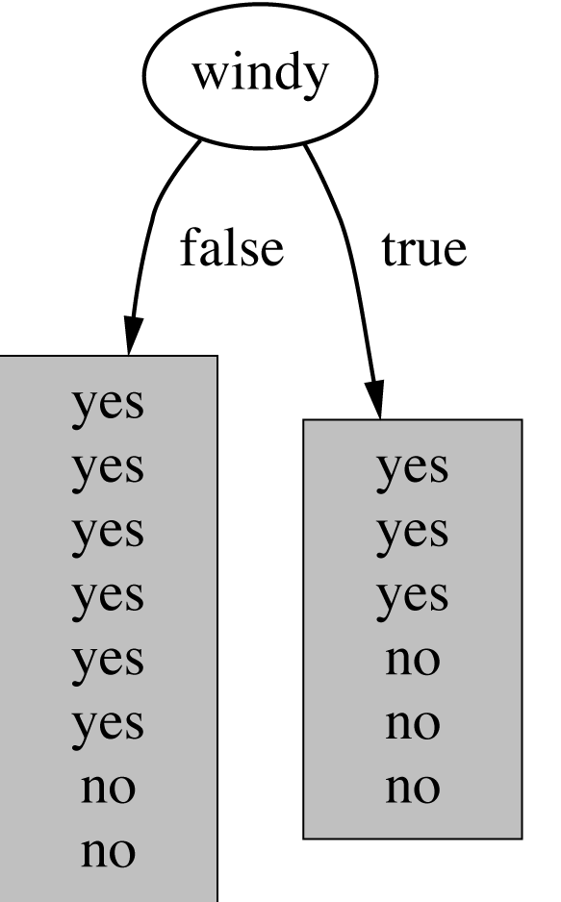
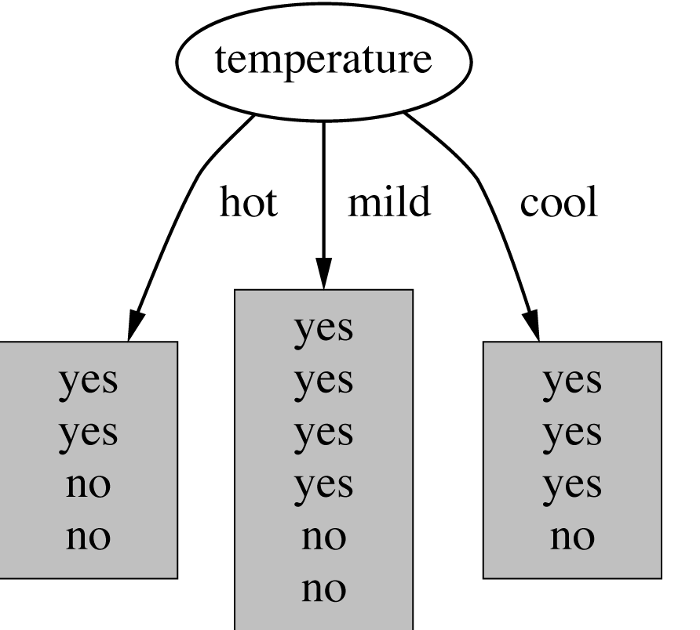
Which attribute to select?
witten&eibe

Slide 15
Choosing the Splitting Attribute
At each node, available attributes are evaluated on the basis of separating the classes of the training examples. A Goodness function is used for this purpose.
Typical goodness functions:
  information gain (ID3/C4.5)
  information gain ratio
  Gini index
Strategy: choose attribute that results in greatest information gain as the root.
witten&eibe

Slide 16
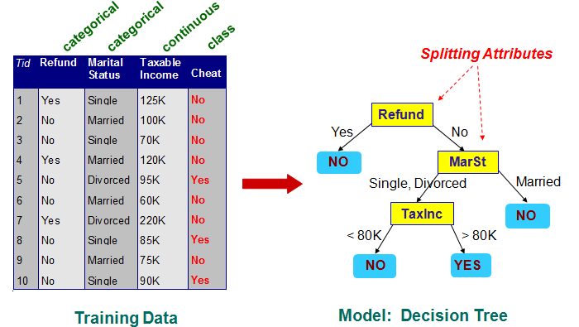
Decision Tree Example

Slide 17
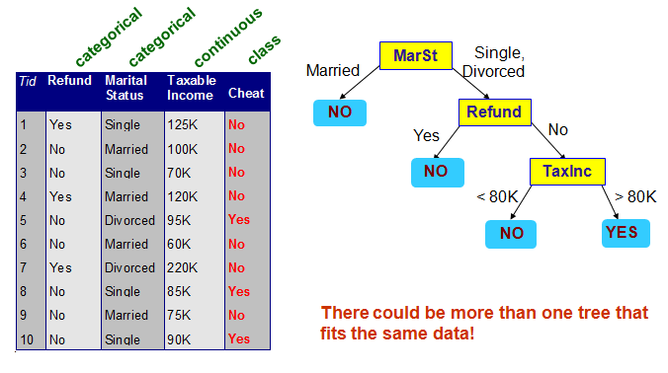
Decision Tree Example- 2

Slide 18
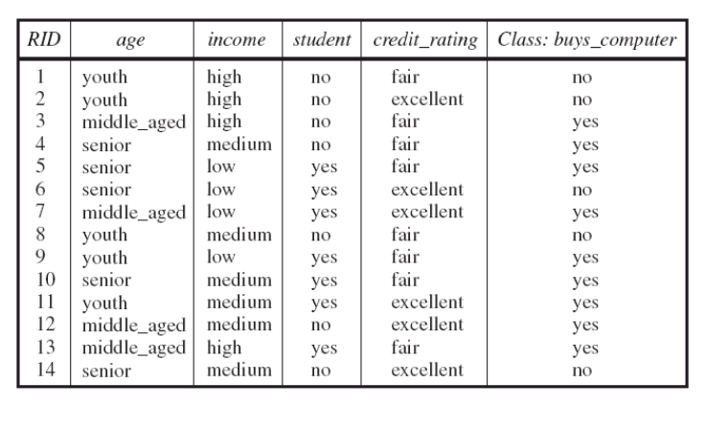
Example: Customer Database

Slide 19
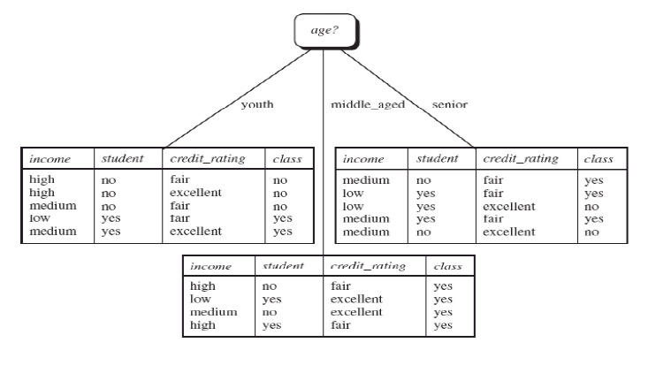
Root: age attribute..

Slide 20
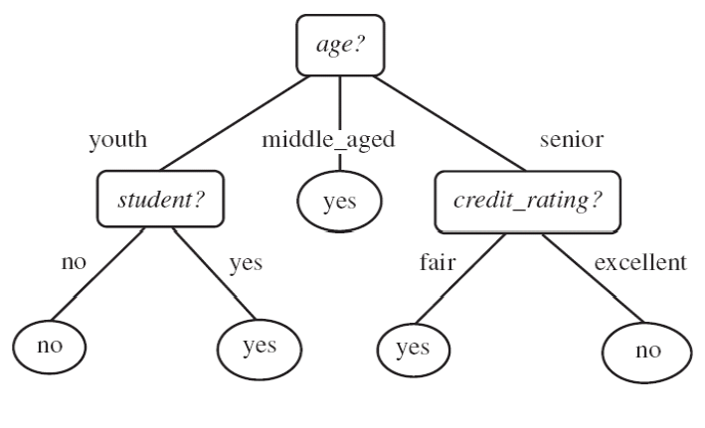
The final decision tree
  ⇒ Splitting stops when data can’t be split any further
witten&eibe

Slide 21
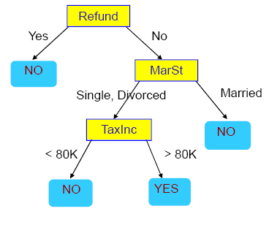
QUESTIONS
Explain classification in Data Mining. Describe the techniques used for classification. Explain the steps of Classification.
2. Why we are using decision trees as a classification method? What are the advantages and disadvantages of using decision trees?
3. According to the given Decision Tree what will be the output for class - cheating (yes or no)?
Refund | Marial Status | Taxable income | Cheat
No | Married | 80K | ?
Yes | Single | 125K | ?

Slide 22
ISE 350 DATA WAREHOUSING AND DATA MINING
Classification Techniques: Rule Based Algorithms

Slide 23
Recall:
CLASSIFICATION TECHNIQUES
Classification is about determining the class of a given record by applying a classification model.
Classification Techniques:
  1. Decision Trees (e.g. ID3, C4.5, C5.5(j48))
  2. Rule Based Algorithms
  3. K- Nearest Neighbor Algorithm
  4. Bayesian Classifier
  5. ANN (Artificial Neural Nets)

Slide 24
Rule-Based Classifier
Classify records by using a collection of “if…then…” rules
Rule: (Condition) → y
  where
    Condition is a conjunctions of attributes
    y is the class label
  Examples of classification rules:
    (Blood Type=Warm) ∧ (Lay Eggs=Yes) → Birds
    (Taxable Income < 50K) ∧ (Refund=Yes) → Cheat=No

Slide 25
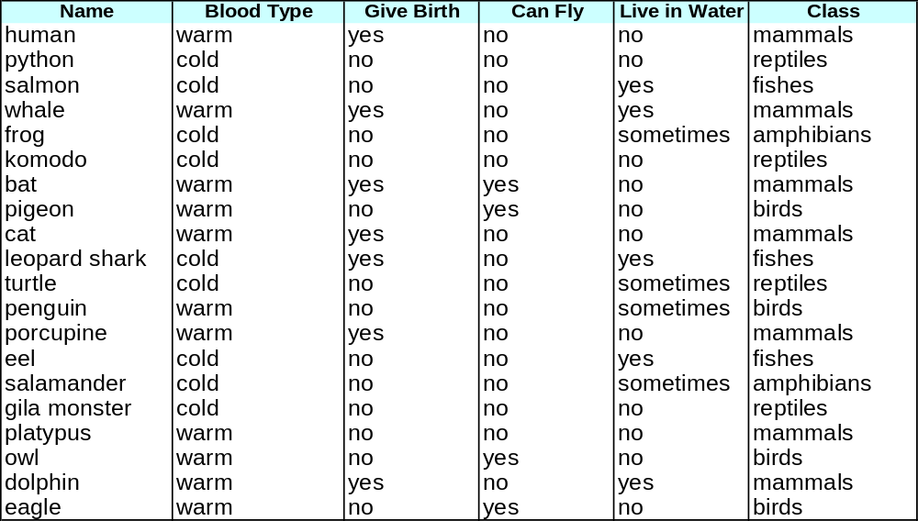
Rule-based Classifier (Example)
R1: (Give Birth = no) ∧ (Can Fly = yes) → Birds
R2: (Give Birth = no) ∧ (Live in Water = yes) → Fishes
R3: (Give Birth = yes) ∧ (Blood Type = warm) → Mammals
R4: (Give Birth = no) ∧ (Can Fly = no) → Reptiles
R5: (Live in Water = sometimes) → Amphibians

Slide 26
Application of Rule-Based Classifier
A rule r covers an instance x if the attributes of the instance satisfy the condition of the rule
R1: (Give Birth = no) ∧ (Can Fly = yes) → Birds
R2: (Give Birth = no) ∧ (Live in Water = yes) → Fishes
R3: (Give Birth = yes) ∧ (Blood Type = warm) → Mammals
R4: (Give Birth = no) ∧ (Can Fly = no) → Reptiles
R5: (Live in Water = sometimes) → Amphibians
The rule R1 covers a hawk => Bird
The rule R3 covers the grizzly bear => Mammal

Slide 27
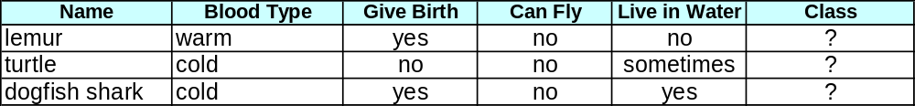
Example: How does Rule-based Classifier Work?
R1: (Give Birth = no) ∧ (Can Fly = yes) → Birds
R2: (Give Birth = no) ∧ (Live in Water = yes) → Fishes
R3: (Give Birth = yes) ∧ (Blood Type = warm) → Mammals
R4: (Give Birth = no) ∧ (Can Fly = no) → Reptiles
R5: (Live in Water = sometimes) → Amphibians
A lemur triggers rule R3, so it is classified as a mammal
A turtle triggers both R4 and R5 (PROBLEM!!)
A dogfish shark triggers none of the rules (PROBLEM!!)

Slide 28
Ordered Rule Set
Rules are rank ordered according to their priority
  An ordered rule set is known as a decision list
When a test record is presented to the classifier
  It is assigned to the class label of the highest ranked rule it has triggered
  If none of the rules fired, it is assigned to the default class
R1: (Give Birth = no) ∧ (Can Fly = yes) → Birds
R2: (Give Birth = no) ∧ (Live in Water = yes) → Fishes
R3: (Give Birth = yes) ∧ (Blood Type = warm) → Mammals
R4: (Give Birth = no) ∧ (Can Fly = no) → Reptiles
R5: (Live in Water = sometimes) → Amphibians

Slide 29
Rule Extraction from a Decision Tree
age?
<=30
31..40
>40
Rules are easier to understand than large trees
One rule is created for each path from the root to a leaf
Each attribute-value pair along a path forms a conjunction: the leaf holds the class prediction
Rules are mutually exclusive and exhaustive
student?
yes
credit rating?
no
yes
excellent
fair
no
yes
no
yes
Example: Rule extraction from our buys_computer decision-tree
  IF age = young AND student = no THEN buys_computer = no
  IF age = young AND student = yes THEN buys_computer = yes
  IF age = mid-age THEN buys_computer = yes
  IF age = old AND credit_rating = excellent THEN buys_computer = yes
  IF age = young AND credit_rating = fair THEN buys_computer = no

Slide 30
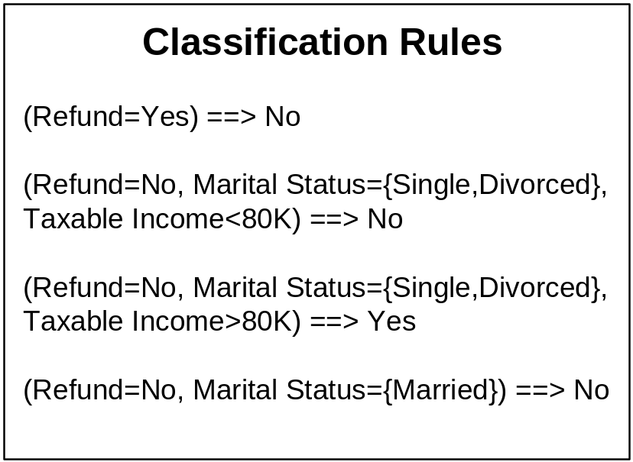
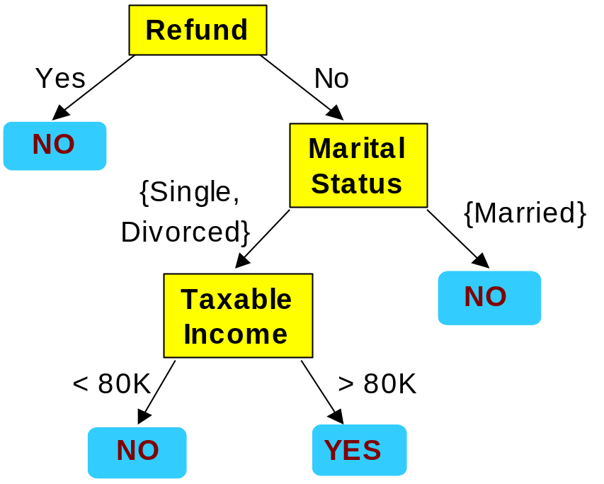
From Decision Trees To Rules
Rules are mutually exclusive and exhaustive
Rule set contains as much information as the tree

Slide 31
Building Classification Rules
Direct Method:
    Extract rules directly from data
    Sequential Covering
    e.g.: RIPPER, CN2, Holte’s 1R
Indirect Method:
    Extract rules from other classification models (e.g.
    decision trees, neural networks, etc).
    e.g: C4.5rules

Slide 32
Advantages of Rule-Based Classifiers
As highly expressive as decision trees
Easy to interpret
Easy to generate
Can classify new instances rapidly

Slide 33
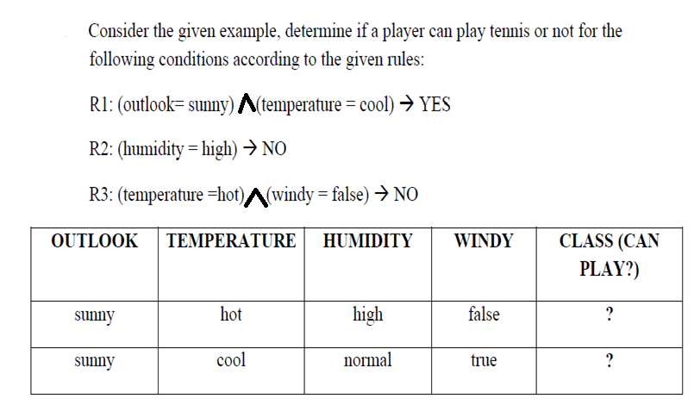
QUESTIONS

Slide 34
ISE 350 DATA WAREHOUSING AND DATA MINING
Classification Techniques: k Nearest Neighbor Algorithm

Slide 35
CLASSIFICATION TECHNIQUES
Classification is about determining the class of a given record by applying a classification model.
Classification Techniques:
  1. Decision Trees (e.g. ID3, C4.5, C5.5(j48))
  2. Rule Based Algorithms
  3. K- Nearest Neighbor Algorithm
  4. Bayesian Classifier
  5. ANN (Artificial Neural Nets)

Slide 36
Lazy vs. Eager Learning
  Eager learning (decision trees & rule based classifiers): Given a set of training set, constructs a classification model before receiving new (e.g., test) data to classify
  Eager leaners spend bulk of their resources in model development. Classifying a test sample is fast.
  Lazy learning: (learning from neighbors- e.g., instance-based learning): Simply stores training data and waits until it is given a test tuple.
Lazy: less time in training but more time in predicting

Slide 37
Lazy Learner: Instance Based Classifiers
Examples:
  Nearest neighbor
    Find training samples that are relatively similar to the attributes of test example.
    Uses k “closest” points (nearest neighbors) for performing classification

Slide 38
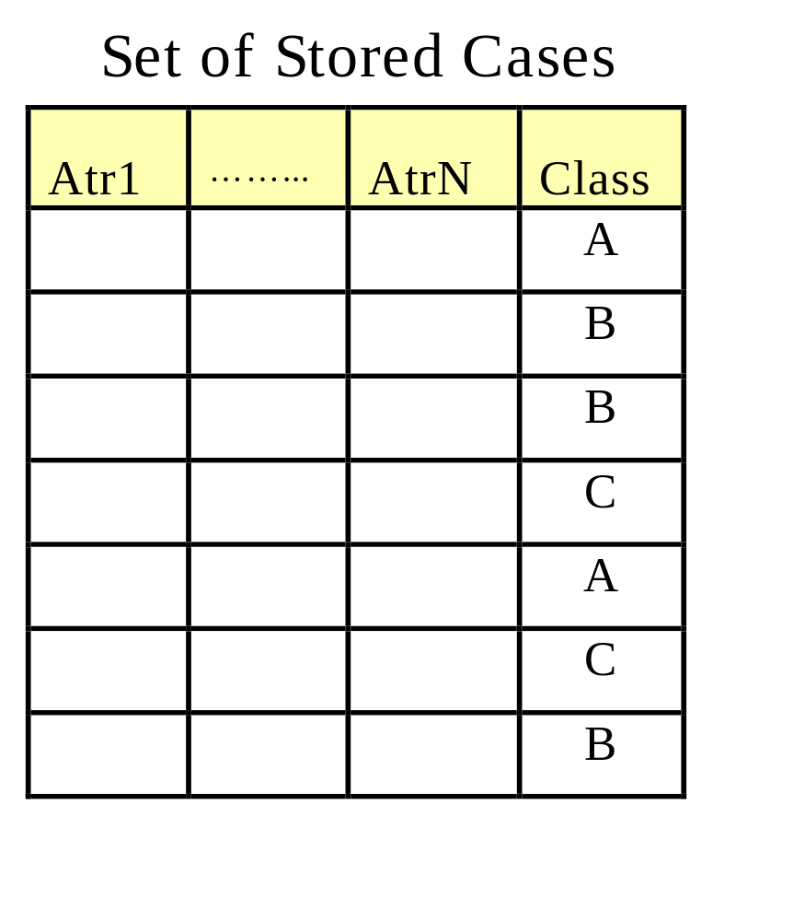
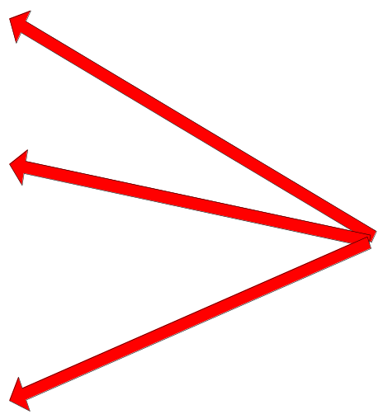
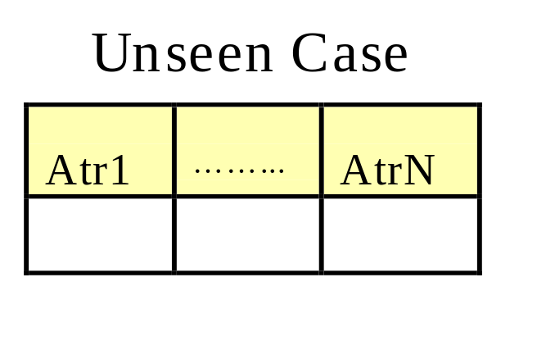
Instance-Based Classifiers
Store the training records
Use training records to
predict the class label of
unseen cases

Slide 39






Nearest Neighbor Classifiers
Basic idea:
  If it walks like a duck, quacks like a duck, then it’s probably a duck
Compute Distance
Test Record
Training Records
Choose k of the “nearest” records

Slide 40
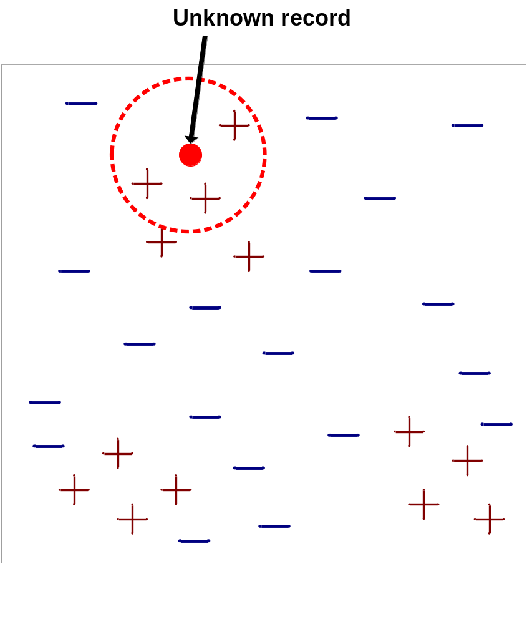
Nearest-Neighbor Classifiers
Requires three things
  The set of stored records
  Distance Metric to compute distance between records
  The value of k, the number of nearest neighbors to retrieve

Slide 41
Nearest-Neighbor Classifiers
To classify an unknown record:
  Compute distance to other training records
  Identify k nearest neighbors
  Use class labels of nearest neighbors to determine the class label of unknown record

Slide 42
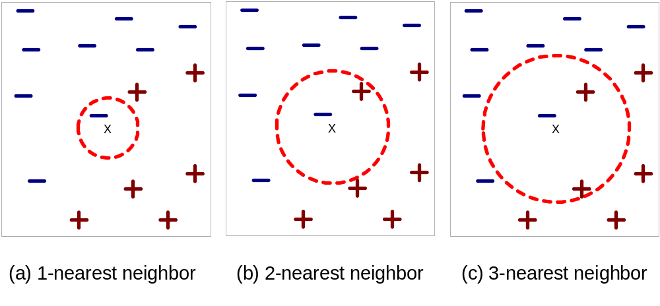
Definition of Nearest Neighbor
K-nearest neighbors of a record x are data points that have the k smallest distance to x
Note: b) We may randomly choose positive or negative to classify data point

Slide 43
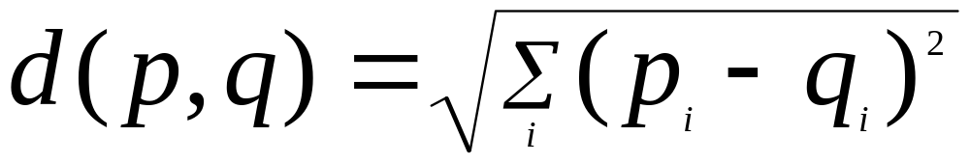
Nearest Neighbor Classification
Compute distance between two points:
  Euclidean distance
Determine the class from nearest neighbor list

Slide 44

Example
Decide “What is Customer No. 5 most likely to buy?" based on the Nearest Neighbor algorithm.

Slide 45
Example
Step 1: Determine Distance Formula Distance
The distance between the unknown data point and every known data point needs to be computed.
= SQRT( (58 - Age)^2) + (51000 - Income)^2 )
We need to calcute the distance between all attributes and attributes of Customer No. 5.

Slide 46

Example- Result:
What is Customer No. 5 most likely to buy?" the answer would be a book. This is because the distance between Customer No. 5 and Customer No. 1 is less than the distance between Customer No. 5 and any other customer.

Slide 47
Example- Result:
Based on this model, we say that the customer most like Customer No. 5 can predict the behavior of Customer No. 5. If we want to know the two most likely products to be purchased by Customer No. 5, we would conclude that they are books and a DVD.

Slide 48
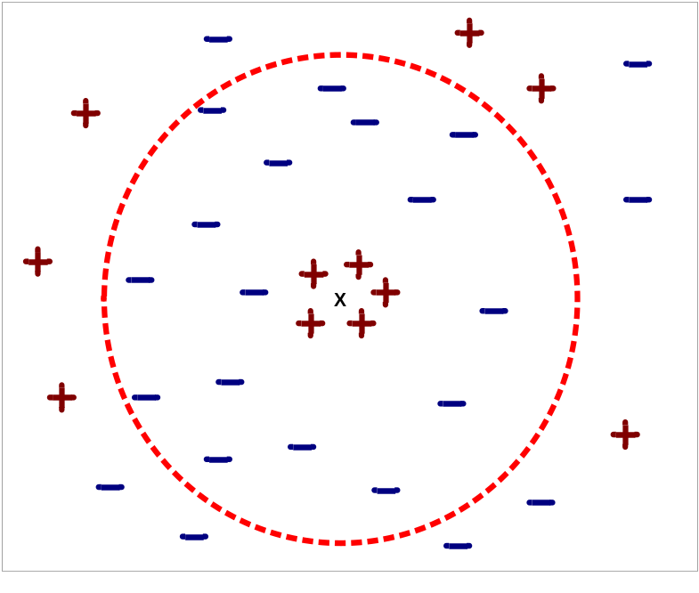
Nearest Neighbor Classification…
Choosing the value of k:
  If k is too small, sensitive to noise points
  If k is too large, neighborhood may include points from other classes

Slide 49
Summary: Nearest neighbor Classification…
k-NN classifiers are lazy learners and a part of instant based learning technique.
They don’t require model building. (Unlike eager learners such as decision tree and rule-based systems)
Classifying unknown records are expensive because the proximity values between test and training samples should be calculated individually.

Slide 50
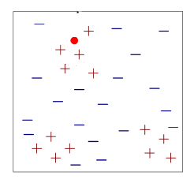
QUESTIONS
For nearest neighbor classifiers, we should use a distance metric to compute the distance between objects and identify k nearest neighbors to decide an unknown object is belong to which class. Do you think k value is important? Explain briefly.
According to nearest neighbor classification method for k=6, unknown record belongs to which class.

